Slide 1

Simple DNS Server with BPF
Martin Lau, Raman Shukhau
Notes:
Hello, as a last talk today i’ll tell you a story about implementing lightweight DNS server with BPF.

Slide 2

Packet Filtering & Processing
Custom Congestion Control
Container Networking
Performance Profiling & Observability
Tracing & Debugging
Security & Monitoring
Custom Schedulers & I/O Accelerators
GPU Profiling
Kernel Debugging
BPF “usual” use-cases
Notes:
At this point there are multiple applications for BPF, we are using most of them at Meta in different projects.

Slide 3

BPF can also reply to network packets
Notes:
BPF can also act as a simple server for certain protocols, but is not a replacement for full-featured user-space servers. It can be excellent at fast, stateless responses and packet manipulation at the kernel level.

Slide 4

What Network Protocol is a good use-case?
DNS
Notes:
One of a good examples for this use-case is DNS. It’s UDP based protocol and requests are stateless with a single packet for a request and a single packet for a response.

Slide 5
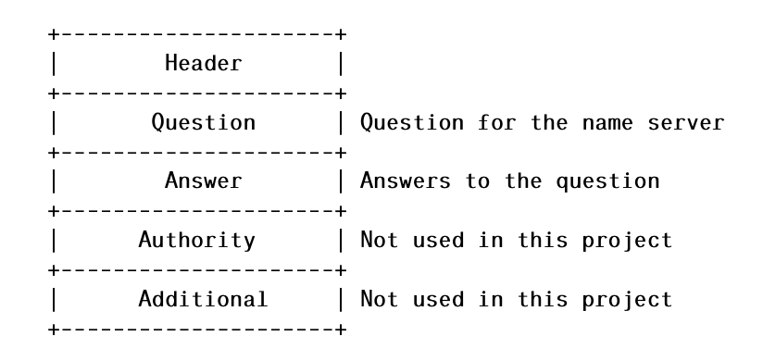
DNS Structure Request
Notes:
Let’s look at a structure of DNS packet. All DNS packets have the following structure as on this picture. To build a simple example with BPF, we can limit our logic to Header/Question/Answer sections.

Slide 6
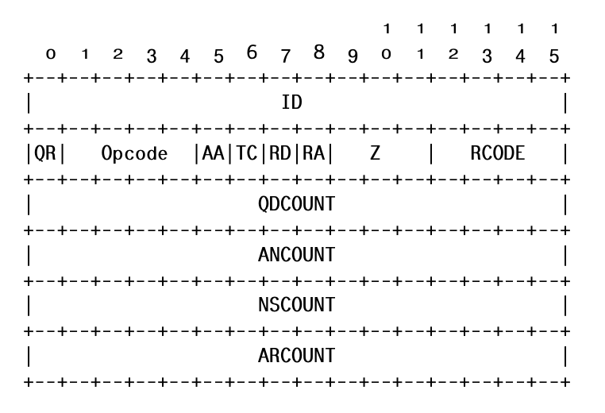
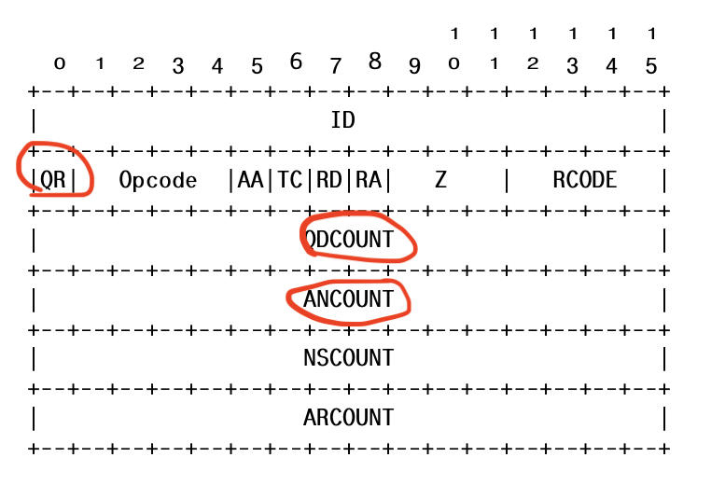
DNS Structure Request: Header
Notes:
Let’s look closer at each section, here are specific fields in the DNS header.
QR A one bit field that specifies whether this message is a query (), or a response ().
QDCOUNT specifies the number of entries in the question section.
ANCOUNT specifying the number of resource records in the answer section.

Slide 7
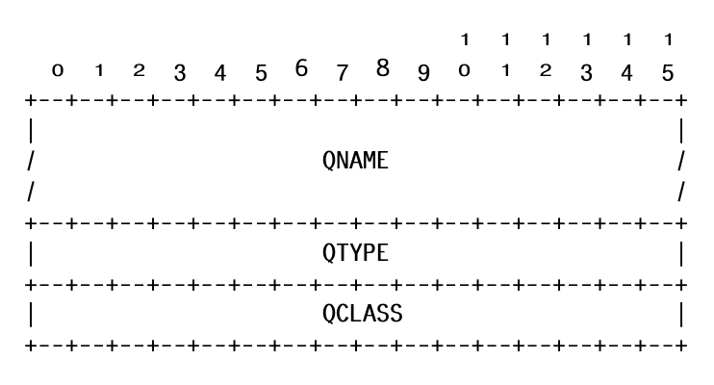
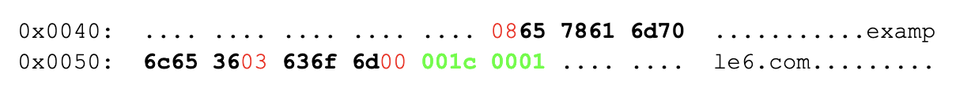
DNS Structure Request: Question
In this example host will be encoded as:
0x08 + example6 +
0x03 + com +
0x00 +
0x001c (type) +
0x0001 (class)
Notes:
QNAME A domain name represented as a sequence of labels, where each label consists of a length octet followed by that number of octets. The domain name terminates with the zero length octet for the null label of the root.

Slide 8
What program types we can use?
Cgroup Types - Not Supported
  routing decision is made at this point
  change to SKB structure limited or not allowed
TC/TCX - Supported
  Can modify SKB and use bpf_redirect
XDP - Supported
  Can change XDP struct and do XDP_TX

Slide 9
What do we need to do?
Swap Source and Destination
Create Answer section
Adjust packet size
Calculate new Checksum
Flip packet “direction”

Slide 10
Preparing DNS Response: Src/Dst
Swap MAC address in ETH header
Swap Src/Dst IP in IPv4/IPv6 header
Swap Ports UDP

Slide 11
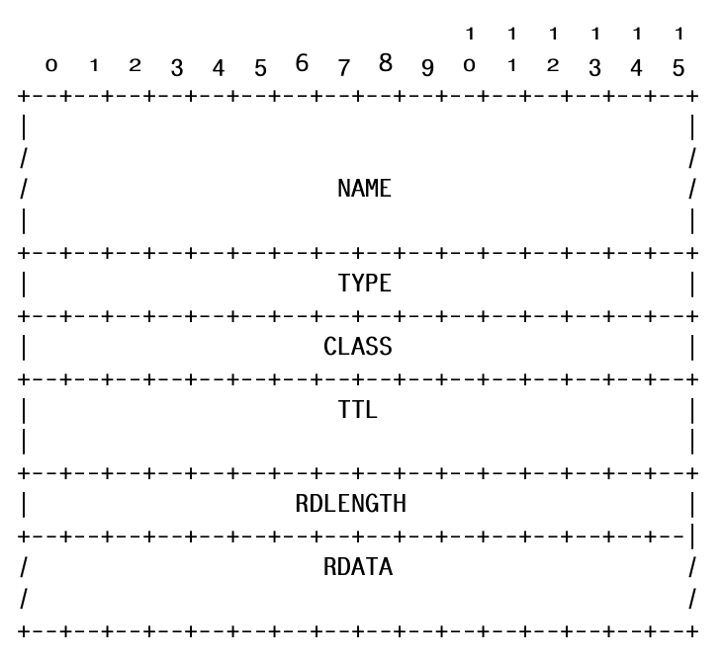
Preparing DNS Response: Answer
Little difference between A (IPv4) & AAAA (IPv6) answers:
Type = 1 (A IPv4) or 28 (AAAA IPv6)
RDLength = 4 or 16
RDATA = IPv4 or IPv6 address
Notes:
NAME The domain name that was queried, in the same format as the QNAME in the questions
RDLENGTH The length of the RDATA field
RDATA The data of the response. The format is dependent on the TYPE field: if the TYPE is 1 for A records and 28 for AAAA then this is the IPv4 or IPv6 address

Slide 12
Preparing DNS Response: Packet Size
sizeof(DNS Header + DNS Name + Domain Info + DNS Answer(s))
Adjust SKB/XDP packet size
Set new UDP/IP packet length

Slide 13
Preparing DNS Response: Checksum
CSUM chain of the following items:
UDP header
DNS Header + DNS Name + DNS Answer(s)
ip6h->saddr
ip6h->daddr
UDP packet len
IPPROTO_UDP
csum_fold at the end to get u16 value

Slide 14
How can we store DNS Records?
struct dns_records {
__u32 a_count;
__u32 aaaa_count;
__u32 a_records[MAX_A_RECORDS];
__u8 aaaa_records[MAX_AAAA_RECORDS][16];
};
struct {
__uint(type, BPF_MAP_TYPE_HASH);
__uint(max_entries, 128);
__type(key, char[MAX_HOSTNAME_LEN]);
__type(value, struct dns_records);
} dns_map SEC(".maps");
… or can use BPF LPM_TRIE Map, but need to “invert” hostname in BPF for lookup.

Slide 15
How can we use DNS BPF?
Resolving external queries
  DNS DDoS Protection (XDP)
Resolving local queries (TC)
  Alternative to local DNS cache server
  Test mocking
Alternative for /etc/hosts (TC)
  More flexible support with similar effort

Slide 16

Use Case: Resolving external queries
No burden with service maintenance
Only simple use-cases supported
better performance with XDP DNS vs. DNS Server
BPF XDP
Unbound DNS Server
Queries per second: 286K
AVG Latency (ms): 0.205
P0 Latency (ms): 0.047
P100 Latency (ms): 4.195
Queries per second: 117K
AVG Latency (ms): 0.772
P0 Latency (ms): 0.062
P100 Latency (ms): 6.785

Slide 17
Use Case: Resolving local queries
No messing with overriding /etc/resolv.conf
Same “no burden with maintenance” point
Same better performance in comparison to local DNS server
BPF TC
Unbound DNS Server
Queries per second: 211K
AVG Latency (ms): 0.008
P0 Latency (ms): 0.004
P100 Latency (ms): 0.891
Queries per second: 179K
AVG Latency (ms): 0.531
P0 Latency (ms): 0.009
P100 Latency (ms): 1.424

Slide 18
Use Case: Alternative for /etc/hosts
Easy to modify list of hosts with BPF Map
Observability with stats/counters/logs
Multiple IP addresses per Entry supported
/etc/hosts is still expected to be faster, as no
network involved

Slide 19


Slide 20

Q&A
Thank you

